Slide 1
CIS 117.02 : Introduction to Web Development
Fall 2022 Dr. Tim Mullins
Lecture 3 – What We Will Cover
Last Time
Block Quote, Font Styles and Sizes
Character Entities
Hypertext Links

Slide 2
Expected a digit but saw p instead
Expected a digit but saw p instead
Last Time
HTML Document Structure, Basic Syntax and Tags, including <img> tag
<!DOCTYPE html>
<html lang="en">
<head>
<title> Assignment 2 </title>
<!-- four required meta tags for assignments, tests] -->
</head>
<body>
<img src="comet.jpg" alt="Picture of comet" >
</body>
</html>

Slide 3

Blockquote, Font Styles and Sizes
Blockquote:
Used to set block of text off from normal flow and appearance of text
Browsers often indent on both sides and sometimes italicize content of <blockquote> …</blockquote>
Font Styles and Sizes (note: can be nested):
Emphasis (often set in italics) <em> … </em>
Strong (boldface) <strong> … </strong>
Monospace (Courier) <code> some code </code>
Superscript <sup> ... </sup>
Subscript <sub> ... </sub>
Example:
x<sub>2</sub><sup>3</sup>
$$x_{2}^{3}$$
Notes:
Textbook, pp. 46-7. Doesn’t cite a source (not required) and displays two paragraphs within blockquote tags.
Go to w3schools.com -> html tutorial -> search for blockquote, which does cite a source: <blockquote cite=“http://www . . .” Try it. Run it.

Slide 4
Character Entities, (Special Symbols)
https://www.toptal.com/designers/htmlarrows/
https://www.w3schools.com/html/html_symbols.asp
Character Entity Meaning
& &amp; Ampersand
< &lt; Less than
> &gt; Greater than
" &quot; Double quote
' &apos; Single quote
¼ &frac14; One quarter
½ &frac12; One half
¾ &frac34; Three quarters
° &deg; Degree
(space) &nbsp; Non-breaking space
© &copy; Copyright
€ &euro; Euro
Notes:
Textbook, pp. 47-8.
First URL above is fun and very instructive.
Go to w3schools link above. Try it. Run some of them. Helps it sink in.

Slide 5
Hypertext Links
Anchor element, the <a> tag, points to target of link – specifies address of that target.
href (hypertext reference) attribute of <a> is assigned value in double quotes – target document.
Anchor element specifying a link is source of the link. The link text (green below) is visible to reader.
Example of target document in same directory:
<a href="MyComets.html">Link to comet info</a>
Example of target document in another directory:
<a href=“images/MyComets.html">Link to comet info</a>
Example of target needing a complete URL:
<a href="https://en.wikipedia.org/wiki/Comet">More comet info</a>
Notes:
Textbook, pp. 55-58. Green texts are actually black in link elements, but typically appear in web browser underlined and a different color such as green.
HTML <a> tag defines a hyperlink.

Slide 6
Hypertext Links (cont.)
If target is not at beginning of linked document, target spot must be marked
Target labels can be defined in many different tags with id attribute
<h1 id="comets">Comets</h1>
The link to an id must be preceded by pound sign (#)
Example when id is in same document:
<a href="#comets">More about comets</a>
Example when target id is in different document:
<a href="MyComets.html#comets">More about comets</a>
Notes:
Green texts are actually black in link elements, but typically appear in web browser underlined and a different color such as green.

Slide 7
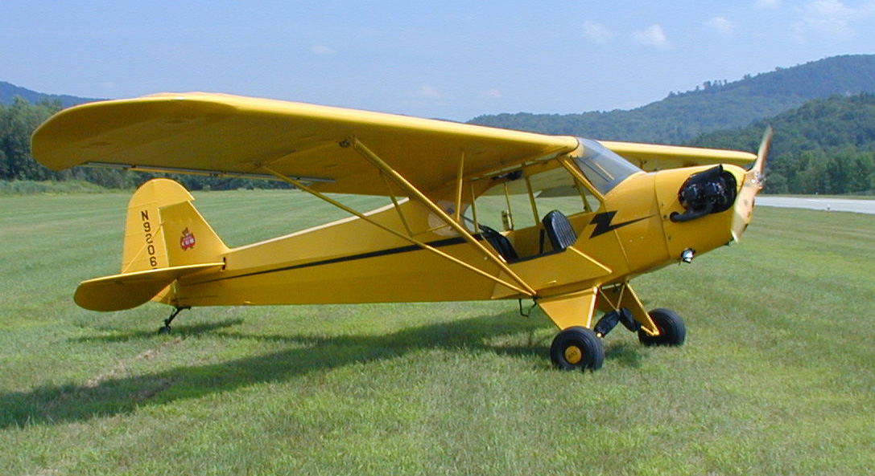
Hypertext Links (cont.)
Links can include images in their content. Remember, we can nest elements!
<a href="c210data.html">
<img src="small-airplane.jpg" alt=“Image of small airplane" >
<br> Information on Cessna 210
</a>
________ [these 4 lines display in browser as below] ________
Information on Cessna 210 [Study at link below]
https://www.itss.Brockport.edu/~tmullins/cis117/Week3/AirplaneExample/
Notes:
The user sees both the small airplane image and the underlined differently-colored clickable link below it.
See two html (temporary txt) files in module along with two jpg files. Change txt files to html files and try them by first running link.html
Better: copy link on bottom of slide and paste in Chrome or Firefox Omnibox/Address Bar.

